Slide 1

Vehicle Plate Smart Scan using YOLO Algorithm
Presented By:
Project Guide
Prof.Vaibhav Yavalkar
Group Members | Moodle ID
Krishna Gupta | 21107024
Meris Gada | 21107041
Tushar Goud | 21107027
Prathamesh Babar | 21107058

Slide 2
Introduction
Vehicle plate recognition is a critical component in various applications, including traffic management, parking systems, and law enforcement.
Traditional methods often rely on complex algorithms and expensive hardware, limiting their scalability and accessibility.
However, with advancements in computer vision and machine learning, a more efficient and cost-effective solution is now possible.
One such solution is the Vehicle Plate Smart Scan using YOLO and Blob detection algorithm project.
This innovative system leverages YOLO and Blob detection algorithm, a technique in computer vision used to detect groups of connected pixels in binary images, to identify and extract number plates from images or video streams.
By focusing on YOLO and Blob detection that exhibit characteristics similar to number plates, such as size, shape, and color, the system can accurately locate and analyze vehicle plates in real-time.

Slide 3
Objectives
To develop a robust, efficient, and cost-effective solution for number plate recognition using Blob & YOLO.
To achieve high accuracy in identifying and extracting number plates from images or video streams using NMS.
To overcome the limitations of traditional methods, such as high costs, complex hardware requirements, and limited scalability.
To ensure the system's robustness against various environmental factors, including variations in lighting, perspective, and plate orientation.

Slide 4
Motivation
The motivation behind the Vehicle Plate Smart Scan using Blob detection and YOLO algorithm project stems from the need to overcome the limitations of existing number plate recognition systems.
Traditional methods, such as template matching and neural network-based approaches, often require extensive computational resources and can be prohibitively expensive to implement and maintain.
Additionally, these methods may struggle with real-world challenges such as varying lighting conditions, occlusions, and non-standard plate formats.

Slide 5
Literature Survey of the existing system
Title | Year | Author | Methods used | Advantages | Results
[1] Number Plate Detection of over speeding vehicle | 2021 | Rishabh Rana, Nidhi Sengar, Amit Goel, Vasudha Bahl | Blob detection Algorithm, Background Subtraction method, Gaussian mixture, Frame differencing & motion based method, Speed Detection. | Detects the speed efficiently and can detects the multiple number plate at a time. | Blob Detection Algorithm, Speed Detection, Background Subtraction.
[2] Video based vehicle speed estimation | 2024 | Keattisak Sangsuwan , Mongkol Ekpangyapong | Speed measurement metrics, Neural network speed estimation | Shows the speed of car accurately | No
[3] Vehicle Number plate recognition | 2019 | Chinmayi Gurav, Vedika Kamble, Rupali Gurav, Neha Sakhalkar | Edge detector, YOLO algorithm Gaussian mixture, Block matching filter, OCR. | Detects the vehicle number plate accurately | OCR, Edge detectors, YOLO algorithm.

Slide 6
Limitations of existing systems
The existing system for vehicle plate smart scan exhibits several limitations that hinder its overall effectiveness.
Firstly, its performance may be inconsistent under varying environmental conditions such as low lighting or adverse weather, which can compromise detection accuracy and reliability.
Additionally, the system may struggle with accurately identifying and recognizing number plates that are partially occluded by other objects or obstructions, leading to missed detections or incorrect recognition.
Processing speed could be another issue, especially in real-time applications, where slow speeds can impact system efficiency and responsiveness.

Slide 7
Problem statement
To develop an automated system capable of accurately detecting and extracting alphanumeric information from number plates in images, designed to be robust enough to handle real-world variations in lighting conditions, plate sizes, orientations, and font styles.

Slide 8
System Design
Capture vehicle videos and images
Images & videos into pre-processing
Non maximum suppression
Predictions
Drawing bounding boxes & text into images
Text extraction
Object detection
Brightness & contrast adjustment
Number plate extraction

Slide 9
6. Technologies and methodologies
Front-End:
  Flask
Middleware:
  Python 3.11.5
Techniques used for detetction:
  Blob Detection model
  YOLO model

Slide 10
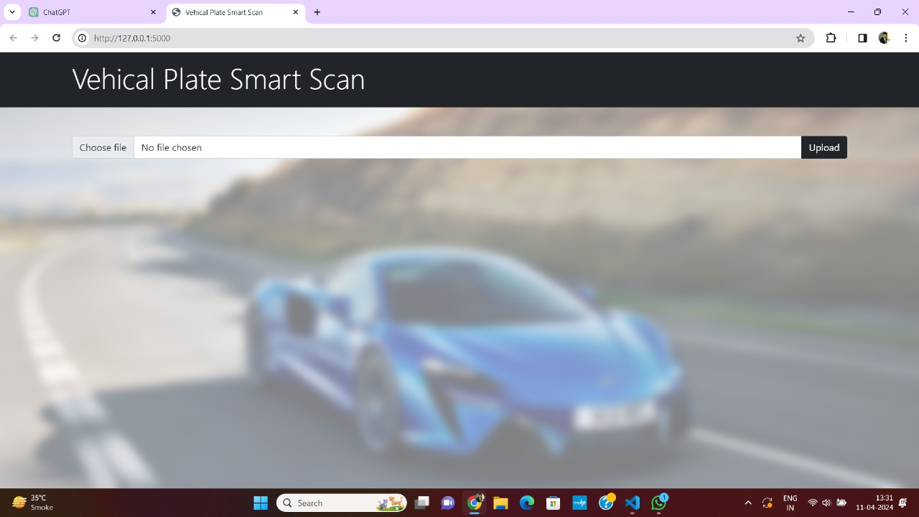
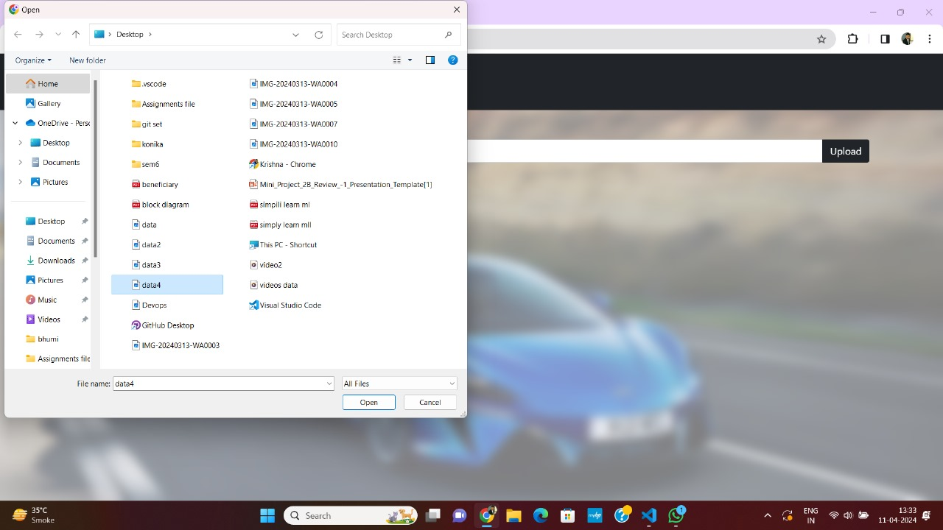
Implementation
Fig 1. Homescreen
Fig 2. Inserting images &videos

Slide 11
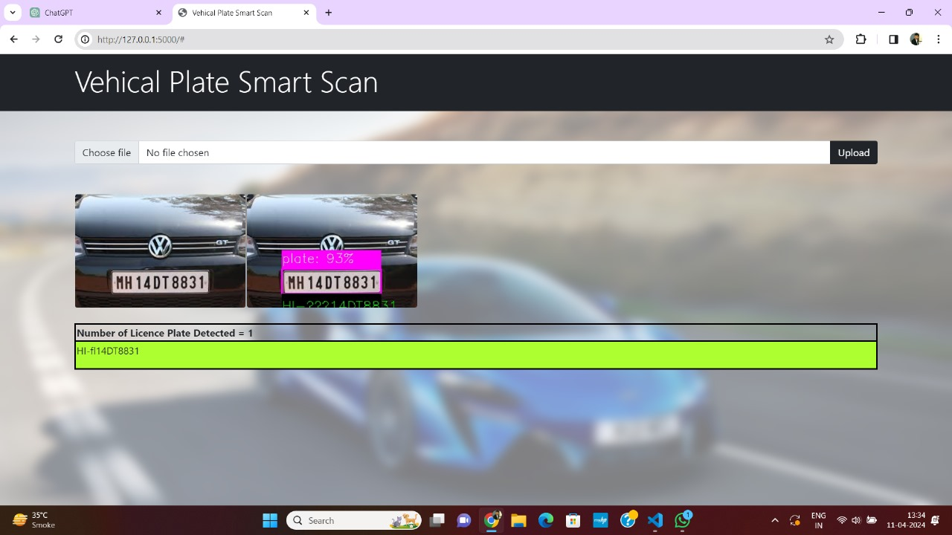
Implementation
Fig 3. Scanned number plate

Slide 12
Conclusion
In conclusion, the implementation of a Vehicle Plate Smart Scan System employing Blob detection and YOLO algorithm technology signifies a significant advancement in automated number plate recognition and monitoring systems.
By harnessing the power of computer vision algorithms, particularly Blob detection and YOLO algorithm, the system can efficiently identify and extract number plate information from images captured by cameras.
The Vehicle Plate Smart Scan System utilizing Blob detection and YOLO algorithm technology represents a promising solution for efficient and reliable number plate recognition, contributing to enhanced safety, security, and efficiency in transportation and surveillance applications.

Slide 13
References
[1] Rishabh Rana, Nidhi Sengar, Amit Goel, Vasudha Bahl. “Number Plate Detection of over speeding vehicle.” _International Research Journal of Modernization in Engineering Technology and Science_6.752 (2021).
[2] Keattisak Sangsuwan, Mongkol Ekpangyapong. “Video based vehicle speed estimation.” _IEEE Paper (2024).
[3] Chinmayi Gurav, Vedika Kamble, Rupali Gurav, Neha Sakhalkar. “Vehicle Number Plate Recognition.” _International Research Journal of Modernization in Engineering Technology and Science (2019).
[4] Anisha Goyal, Rekha Bhatia. “Various techniques for vehicle number plate recognition.” _International Journal of Computer Application_143 (2016).

Slide 14
Thank You...!!

